Slide 1
MULTILAYER PERCEPTRON
TRAINING HANDWRITING
Azwarly Hanef Siregar
M07158027
Teacher : Prof. Chuang-Jan Chang

Slide 2
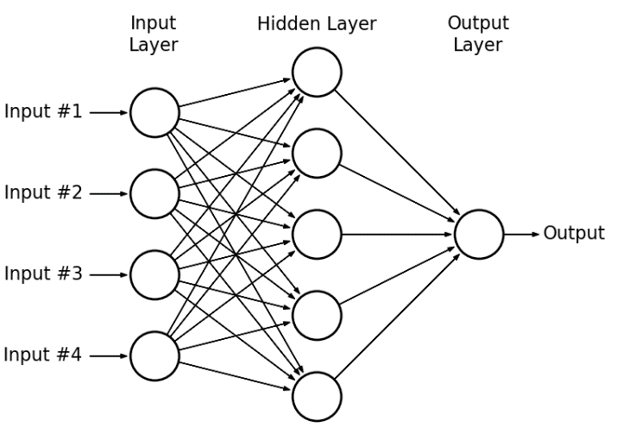
Multilayer Perceptron
Consist of 3 Layers : Input Layer, Hidden Layer, Ouput Layer
MLP utilizes a supervised learning technique called backpropagation for training
Multiple layers and non-linear activation distinguish MLP from a linear perceptron. It can distinguish data that is not linearly separable.
Bias
Weight
Activity Function Is computation to desired output from Input Layer

Slide 3
Main Purpose
?
We will train handwritten digits (0-9) classifier using simple multilayer perceptron

Slide 4
Data Set
Source : https://www.kaggle.com/oddrationale/mnist-in-csv/home
Using a sample of MNIST dataset in a CSV format. Instead of using full dataset with 60000 training examples we will use cut dataset of just 10000 examples that we will also split into training and
testing sets.
Each row in the dataset consists of 785 values: the first value is the label (a number from 0 to 9) and the remaining 784 values (28x28 pixels image) are the pixel values (a number from 0 to 255).

Slide 5
Plot the Data
Peek first 25 rows of the dataset and display them as an images to have an example of digits we will be working with.

Slide 6
Split the Data Into Training and Test Sets
In this step we will split our dataset into training and testing subsets (in proportion 80/20%).
Training data set will be used for training of our model.
Testing dataset will be used for validating of the model. All data from testing dataset will be new to model and we may check how accurate are model predictions.

Slide 7
Init and Train MLP Model
This is step to play with model configuration that we want, based on:
Layers (array of numbers where every number represents the number of neuron in specific layer)
Max Iteration (gradient descent algorithm will use to find the minimum of a cost function)
Regularization_param (parameter that will fight overfitting)
Normalize_data (boolean flag that indicates whether data normalization is needed or not)
Alpha (the size of gradient descent steps. You may need to reduce the step size if gradient descent can't find the cost function minimum)

Slide 8
Illustrate Hidden Layers Perceptrons
Each perceptron in the hidden layer learned something from the training process. What it learned is represented by input theta parameters for it. Each perceptron in the hidden layer has 28x28 input thetas (one for each
input image pizel).
Each theta represents how valuable each pixel is for
this particuar perceptron. So let's try to plot how
valuable each pixel of input image is for each
perceptron based on its theta values.

Slide 9
Calculate Model Training Precision
Calculate how many of training and test examples have been classified correctly (precission to be as high as
possible)
In case if training precision is high and precission is low low, It’s mean our model is overfitted ( it work but
not good at classifing
In that case you may want to play with regularization_param parameter to fighth the overfitting

Slide 10
Plot Test Dataset Predictions
Plot First 64 predictions for testing dataset
All green digits on the plot below have been recognized correctly
All the red digits have not been recognized correctly

Slide 11
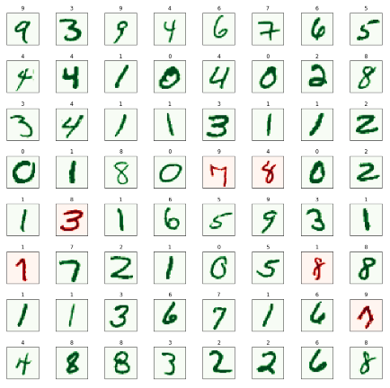
Result
We got result after Predict using MLP
Green Color define for true predict
Red Color define for False Predict

Slide 12
References
Https://www.kaggle.com/oddrationale/mnist-in-csv/home
Https://github.com/trekhleb/homemade-machine-learning/blob/master/notebooks/neural_network/multilayer_perceptron_demo.ipynb
Https://scikit-learn.org/stable/modules/neural_networks_supervised.html

Slide 13
Terima Kasih
Thank’s for Attention
谢谢
ありがとう
ขอบคุณครับ

